Slide 1


An analysis concept to measure atmospheric prompt muons with IceCube Pascal Gutjahr and Mirco Hünnefeld
DPG-Frühjahrstagung, Karlsruhe 2024
Source: NASA

Slide 2
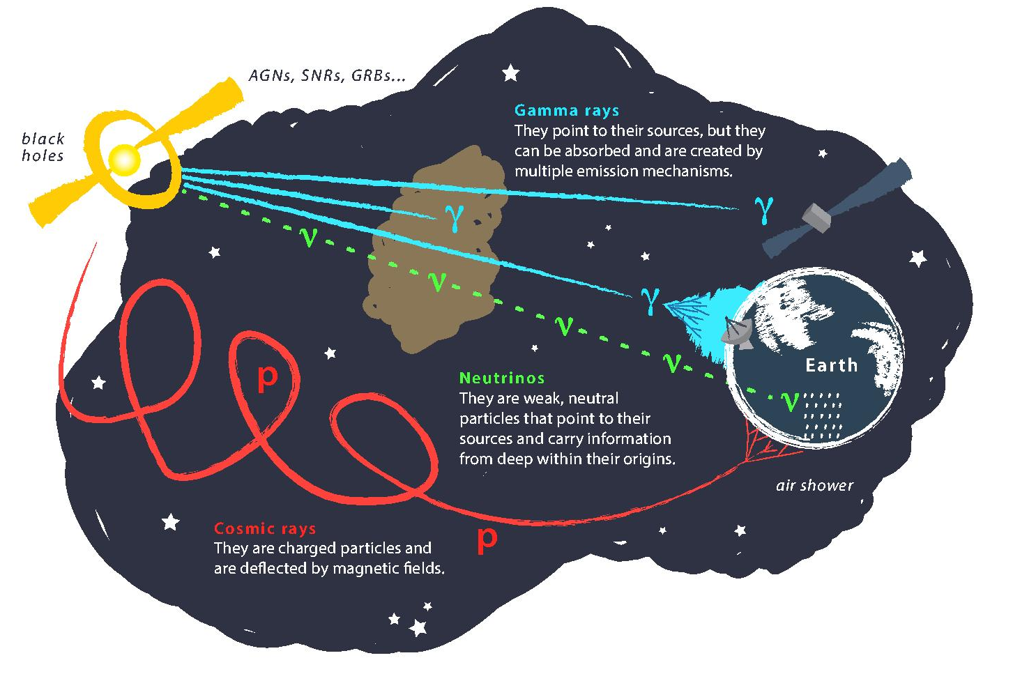
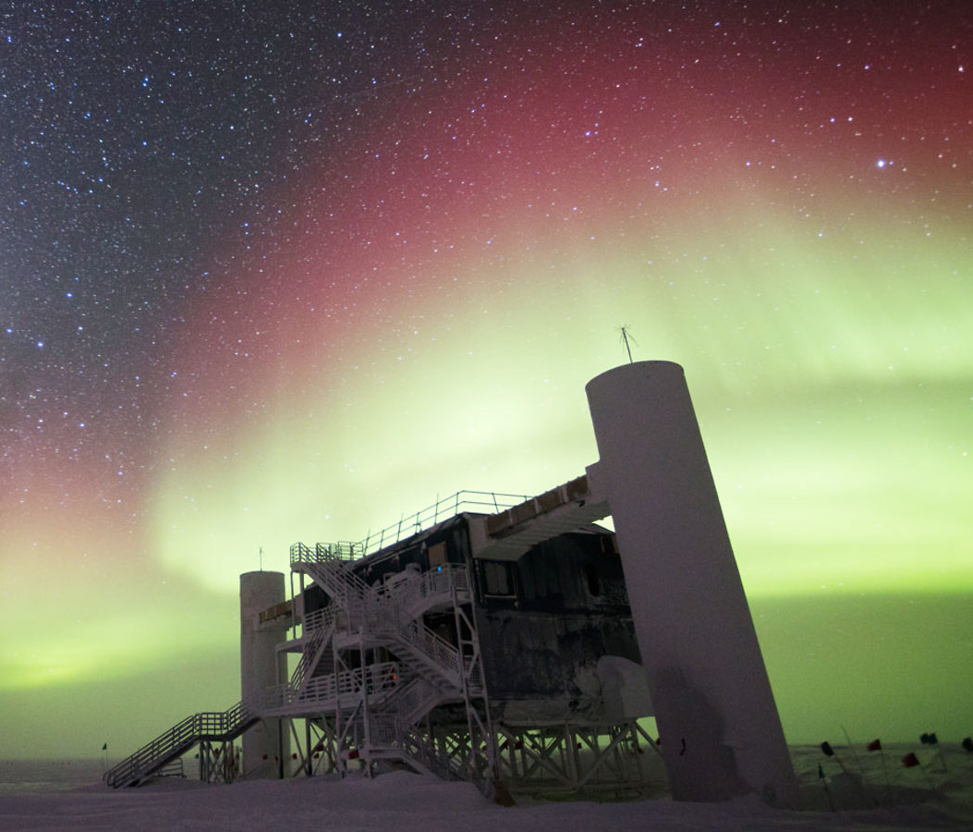
Astroparticle physics
gallery.icecube.wisc.edu
Credit: IceCube / NSF

Slide 3
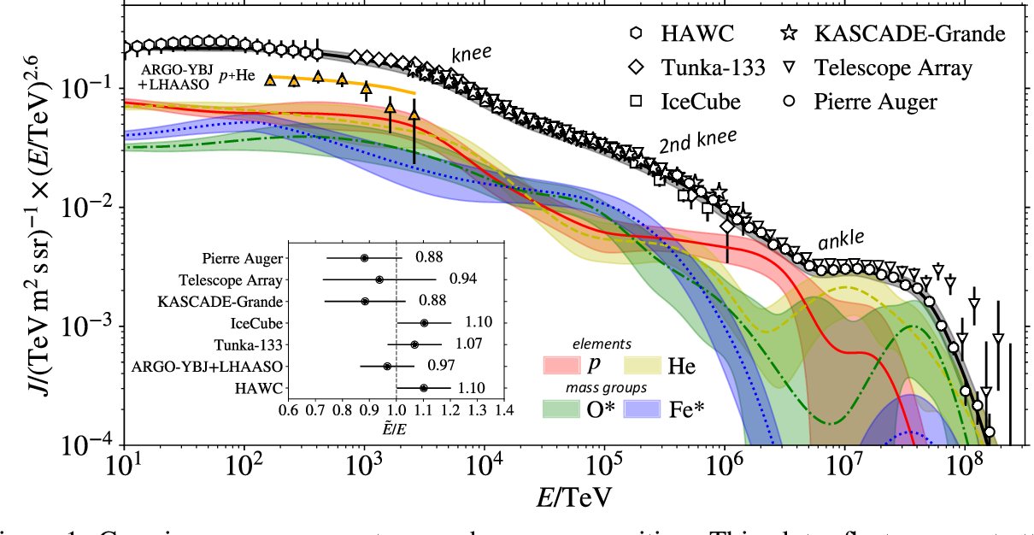
Cosmic ray flux
1903.07713

Slide 4
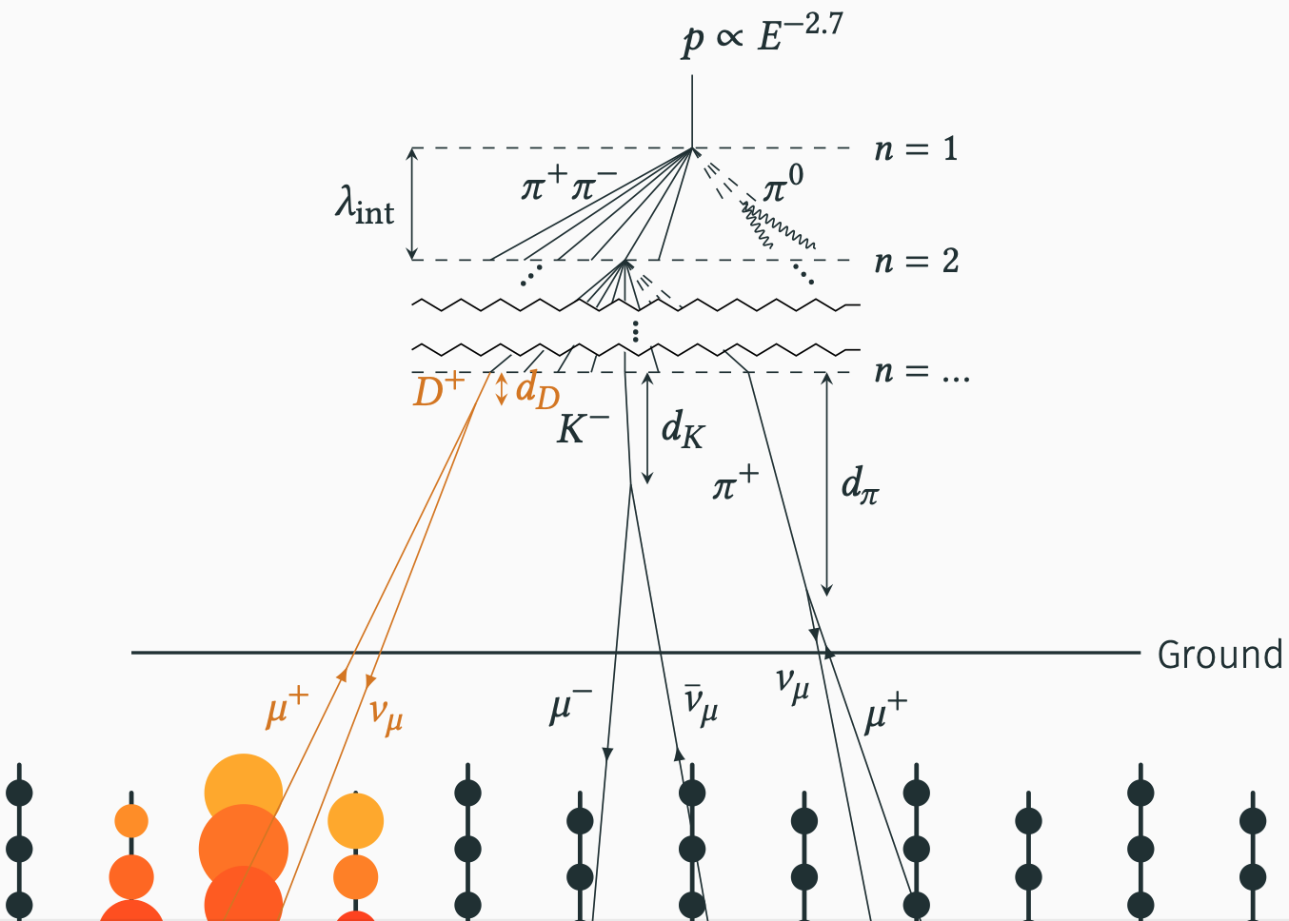
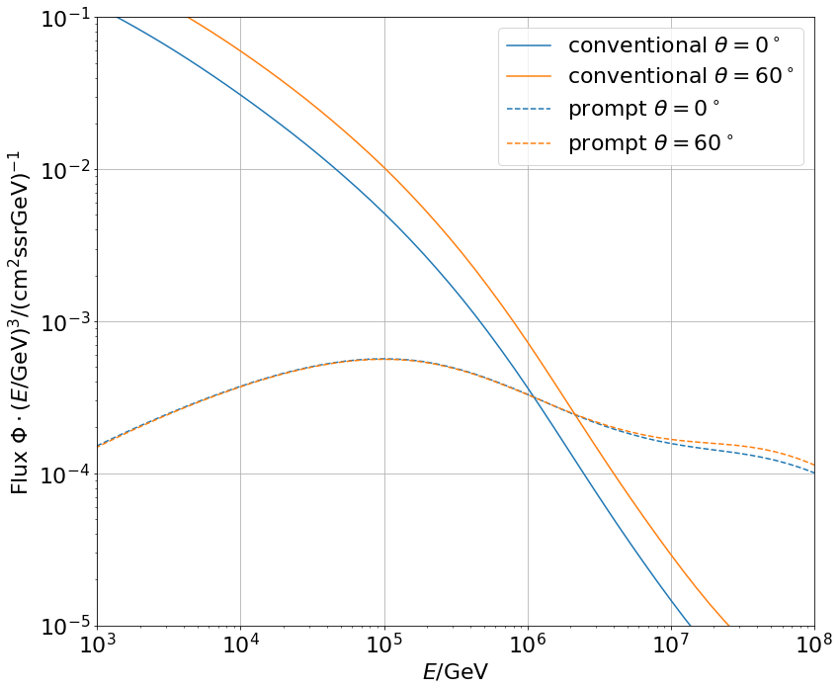

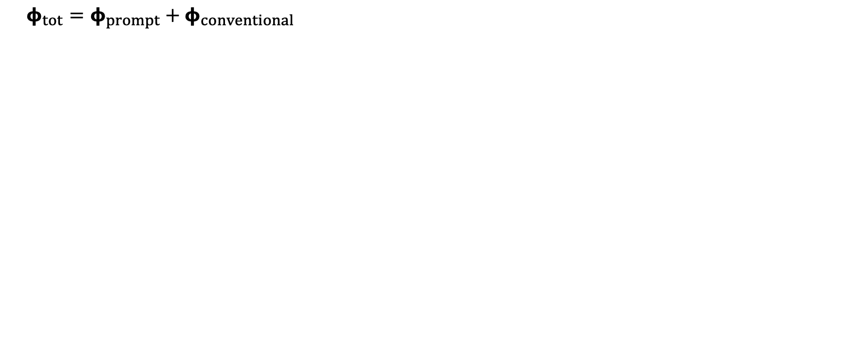
Muon flux: Definition of prompt
Most energetic muon in bundle
Muon parent:
pion or kaon
$φ_{tot}=φ_{prompt}+$ $φ_{conventional}$
yes
no
conventional
prompt
0°: perpendicular to Earth’s surface
conventional
prompt

Slide 5
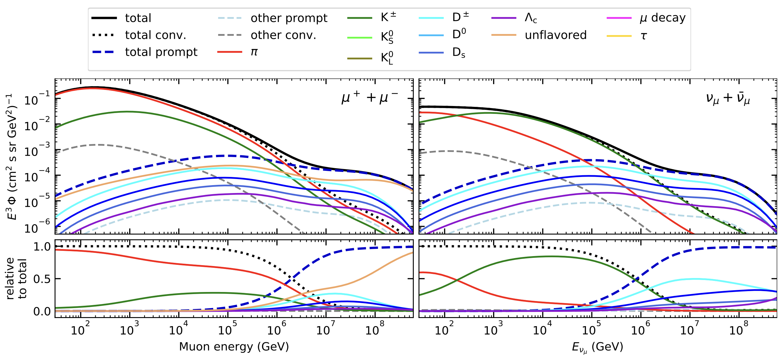
Prompt atmospheric muons and neutrinos
10.1103/PhysRevD.100.103018
no unflavored
dominated by pions
dominated by kaons
Combined fit:
handle on pion/kaon ratio
handle on charmed mesons

Slide 6
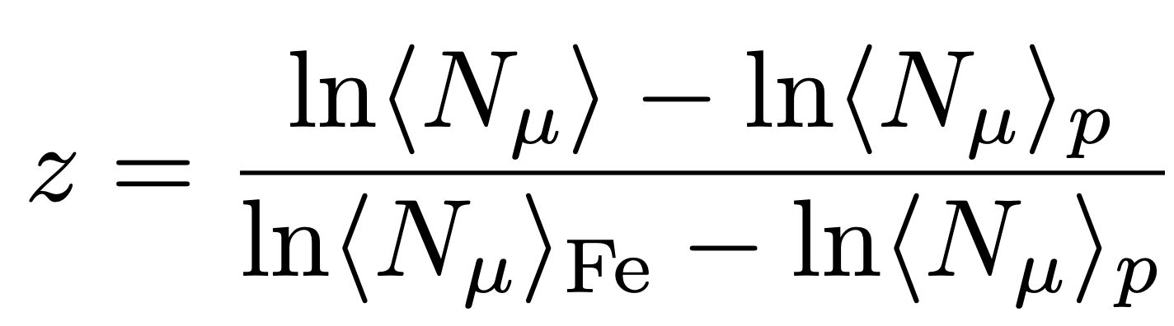
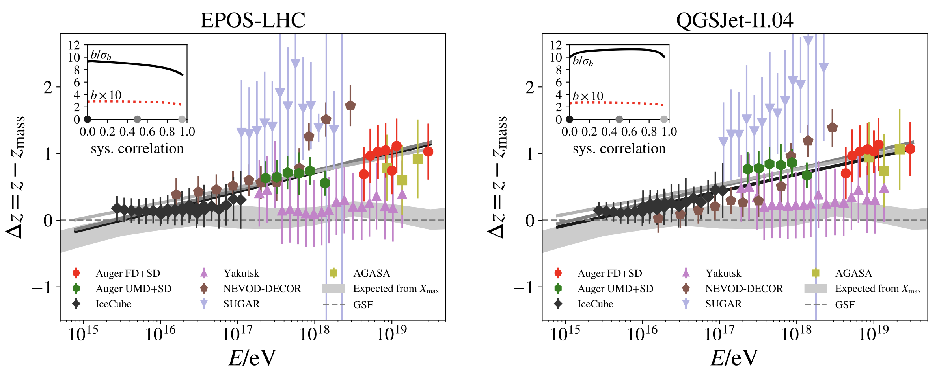
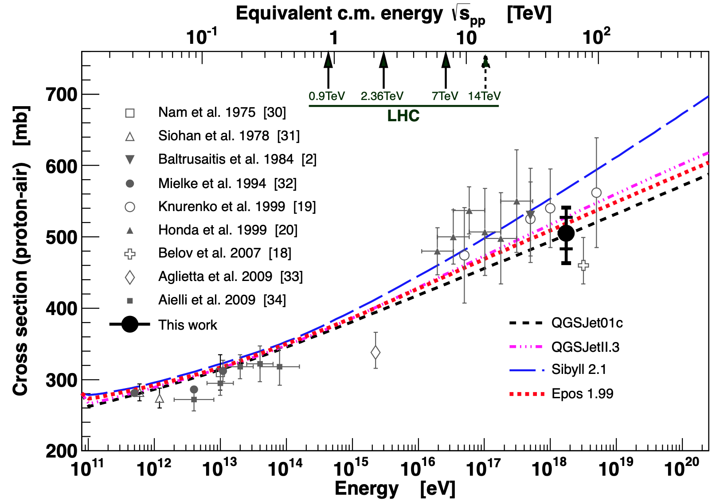
Muon Puzzle and model uncertainties
”muon number”
Expected z
(“muon number”)
2108.08341
1208.1520
More muons measured than simulated for E > 40 PeV ~ cms 8 TeV
Large uncertainties at E > 10 PeV

Slide 7
Intention
Detect prompt component of the atmospheric muon flux
Measure the normalization
Get handle on hadronic interaction models
Idea:
New CORSIKA simulations with extended history
Tag muons by parent → prompt or conventional
Scale amount of prompt particles
Scaling saves time and resources instead of doing multiple simulations with different interaction models
Perform forward fit of the prompt normalization

Slide 8
CORSIKA 7 tagging and MCEq comparison
MCEq: tool to numerically solve the cascade equations that describes the evolution of particle densities as they propagate through a gaseous, dense medium
https://github.com/mceq-project/MCEq
GSF weighting
GSF weighting
Good agreement in total prompt and conventional muon flux
D⁰ and D_{s} are swapped here but this is fixed in MCEq

Slide 9
Pseudo analysis

Slide 10
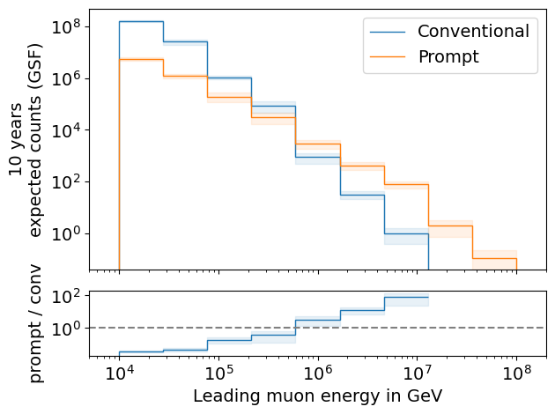
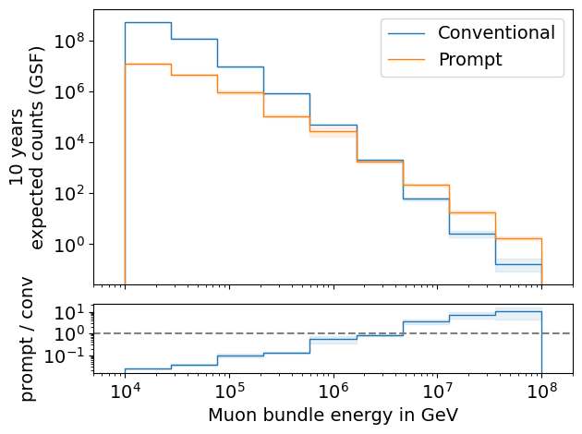
Expected muons for 10 years: leading vs. bundle energy
leading: energy of most energetic muon in a muon bundle
bundle: sum of energies of all muons of the bundle
L2 MuonFilter
L2 MuonFilter
Both leading and bundle energy are sensitive to detect prompt
Leading muon energy is more sensitive

Slide 11
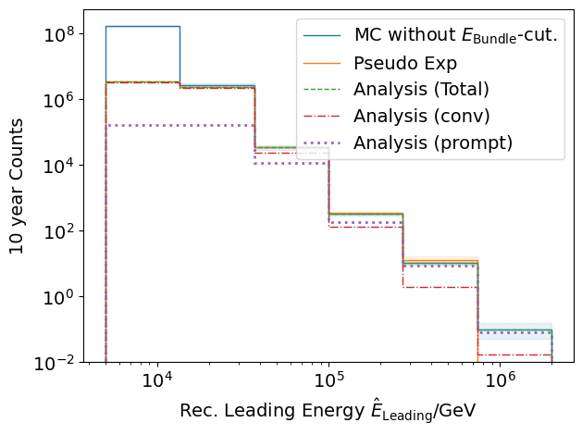
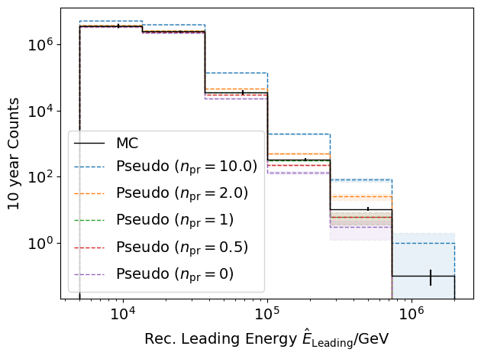
Pseudo data sampling
Cuts:
L2 MuonFilter
Bundle energy > 100 TeV
Tagging allows scaling of prompt by factor n_{pr}

Slide 12
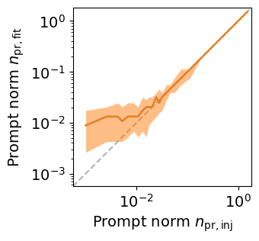
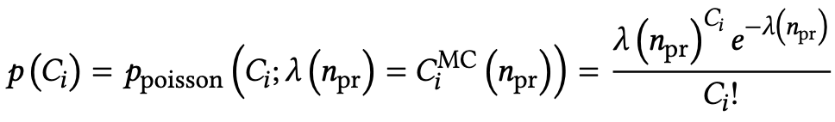
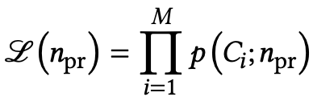
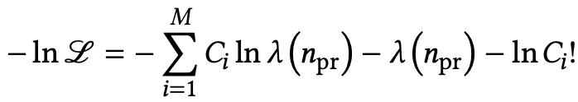
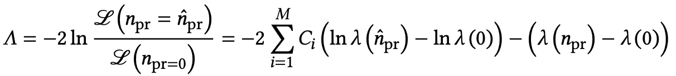
Poisson likelihood fit performed in leading muon energy
Cuts:
L2 MuonFilter
Bundle energy > 100 TeV
Test bias
Prompt scaling/normalization
MC counts per bin i
Conv norm = 1
Experimental counts
Maximize likelihood
With a constant conv norm:
bin counts depend only on prompt norm
= expectation value per bin
Easier:
minimize negative
log-likelihood
Test statistic for Wilks’ theorem
Bias starts at a prompt normalization of 0.1
Null hypothesis: no prompt

Slide 13
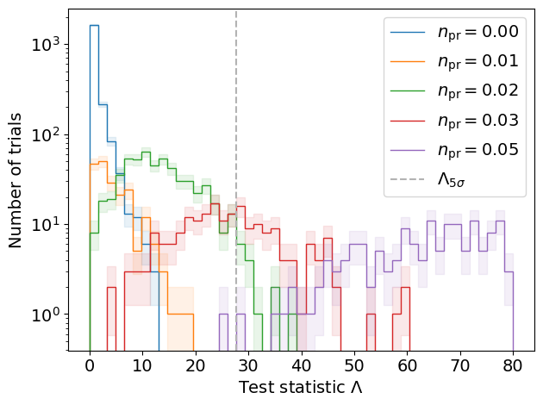
Discovery potential and sensitivity
Cuts:
L2 MuonFilter
Bundle energy > 100 TeV
Expectation for 1 year:
5 sigma discovery potential: 0.102 ± 0.005
Sensitivity: 0.024 ± 0.001
Expectation for 10 years:
5 sigma discovery potential: 0.032 ± 0.001
Sensitivity: 0.007 ± 0.000
Caution:
Limited MC statistics -> events are oversampled in pseudo dataset
No systematic uncertainties

Slide 14
Conclusion and outlook
✓
CORSIKA 7 test simulations
Prompt identification
MCEq comparison
Few-author paper in progress (publish in 2024)
First analysis chain for prompt muon normalization
Proceed analysis…(systematics etc.)
Unfold muon spectrum
Future plan
Combined fit (prompt muons + neutrinos)
Measure pion/kaon ratio -> muon puzzle
✓
✓
★
✓
★
★
Prompt neutrino analysis (Lars Bollmann Tue 16:45, T 42.4)
Thank you for your attention ☺️

Slide 15
Backup

Slide 16
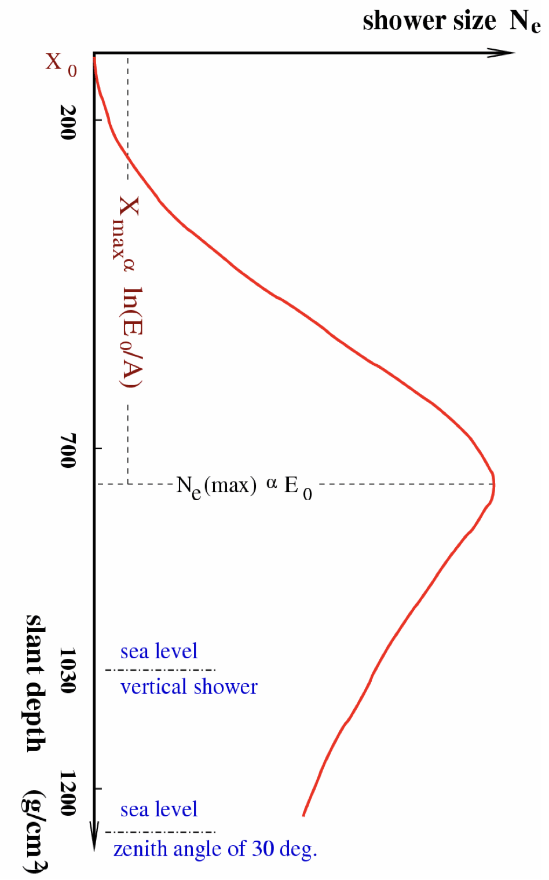
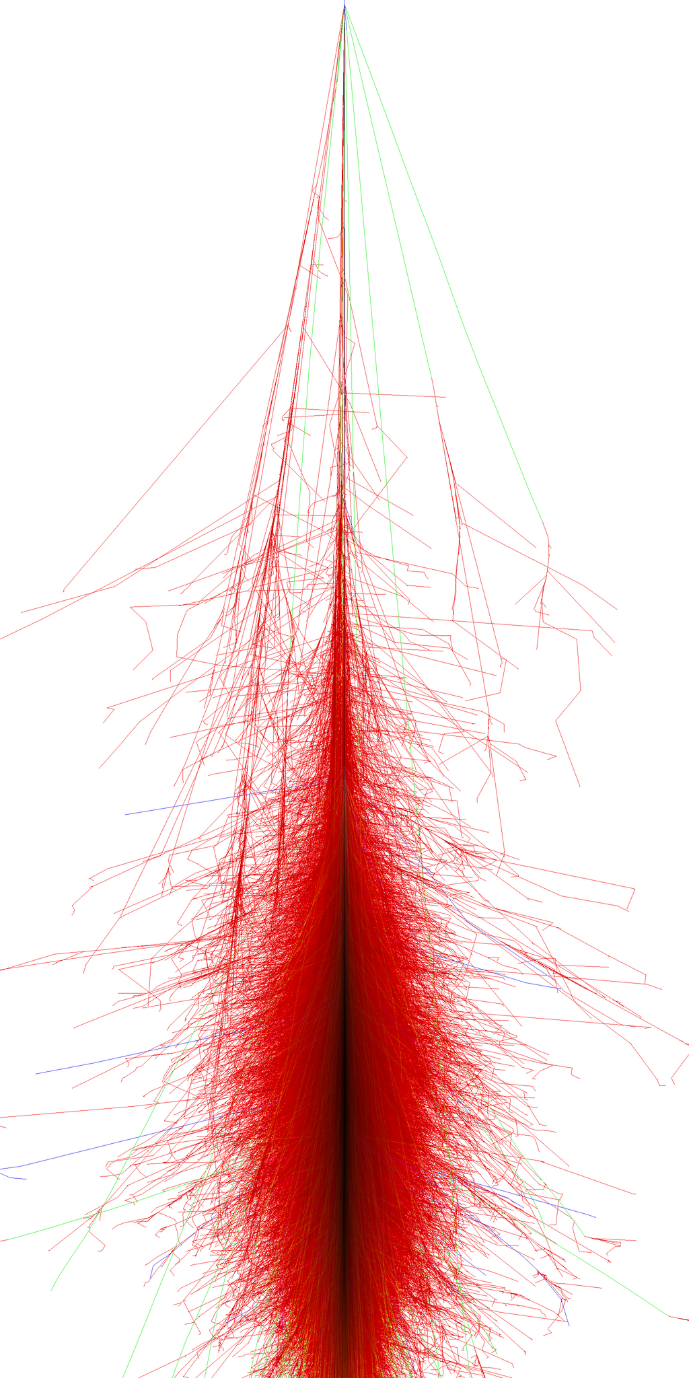
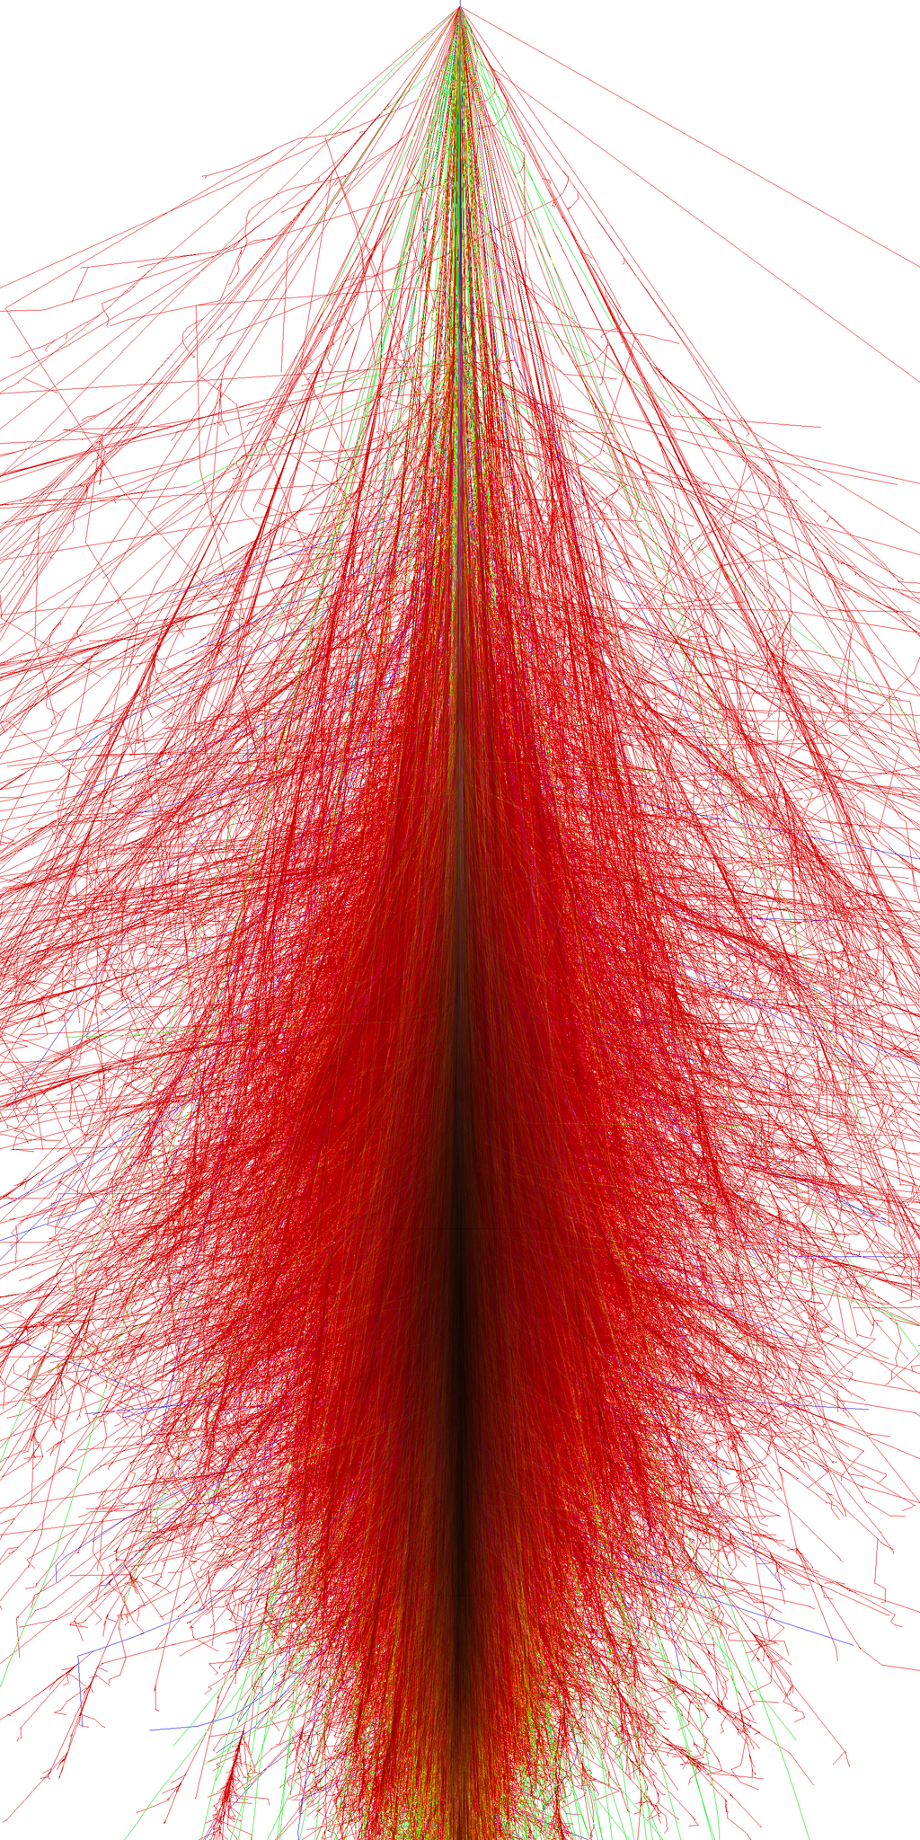
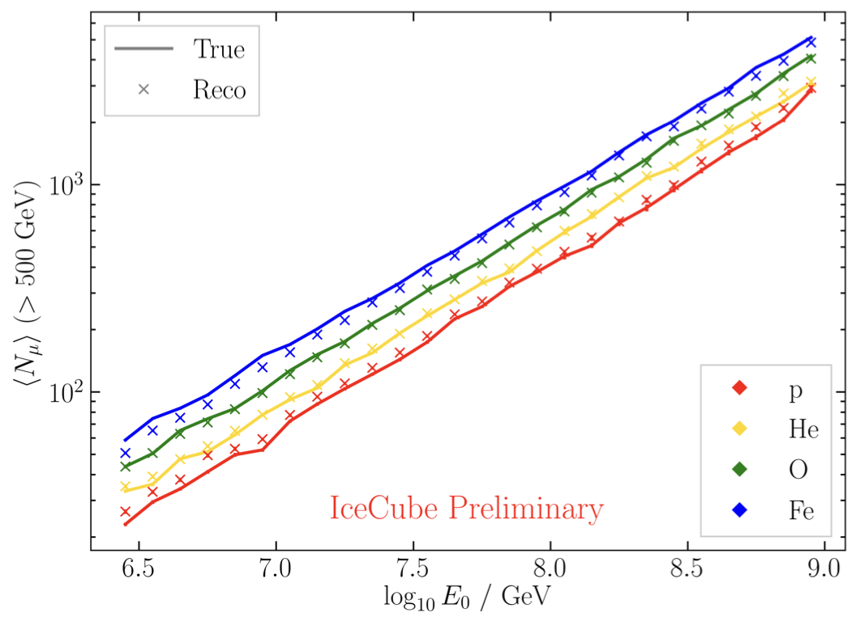
Air shower – 10 TeV
“muon bundles”
zeuthen.desy.de
Ralph Engel 2005
2211.16970v2
Proton
Iron

Slide 17
Agreement for different primary models

Slide 18
MC data exploration

Slide 19
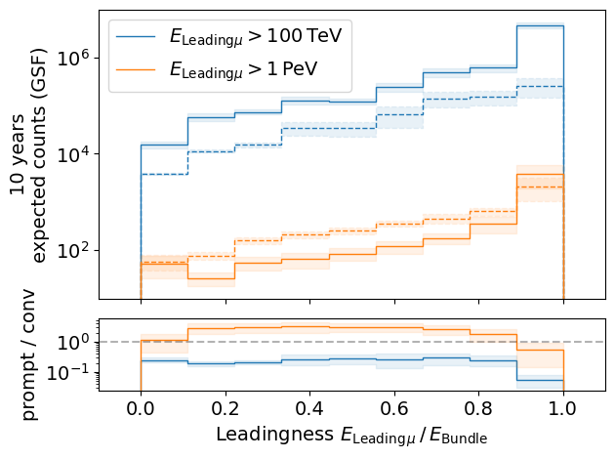
Leading muon energy fraction
Solid: conventional
Dashed: prompt
Prompt dominates for energies > 1 PeV
Leading energy sweet spot: 0.1 – 0.9

Slide 20
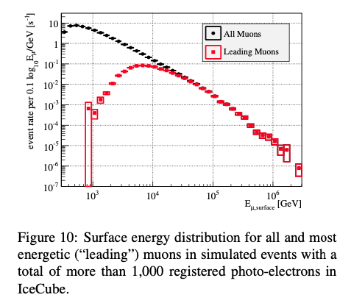
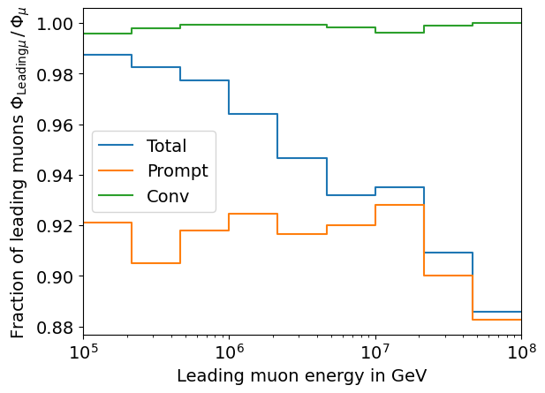
Leading muon contribution
Patrick Berghaus
Muons with energies between 100 TeV and 50 PeV dominate the bundle by more than 90%
In average conventional muons are more dominant than prompt
But: at high energies, there are more prompt than conventional events
High leading energy fraction does not lead to more sensitivity to detect prompt

Slide 21
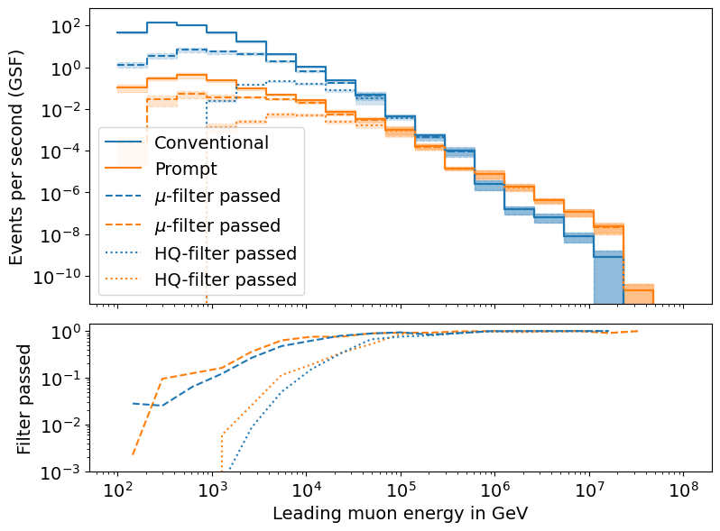
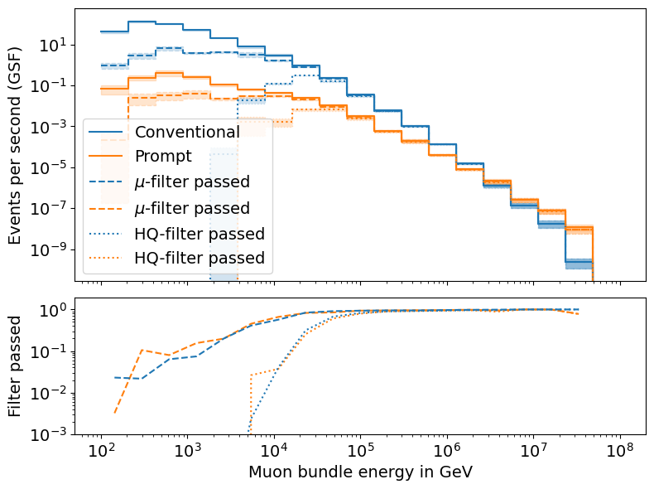
L2 Filters
Fraction events rejected | All energies | Leading energy > 10 TeV | Leading energy > 100 TeV
MuonFilter | 0.93 | 0.28 | 0.06
HQFilter | 0.99 | 0.74 | 0.18
Choose muon filter to remove large amount of statistics at low energies

Slide 22
DNN reconstructions

Slide 23
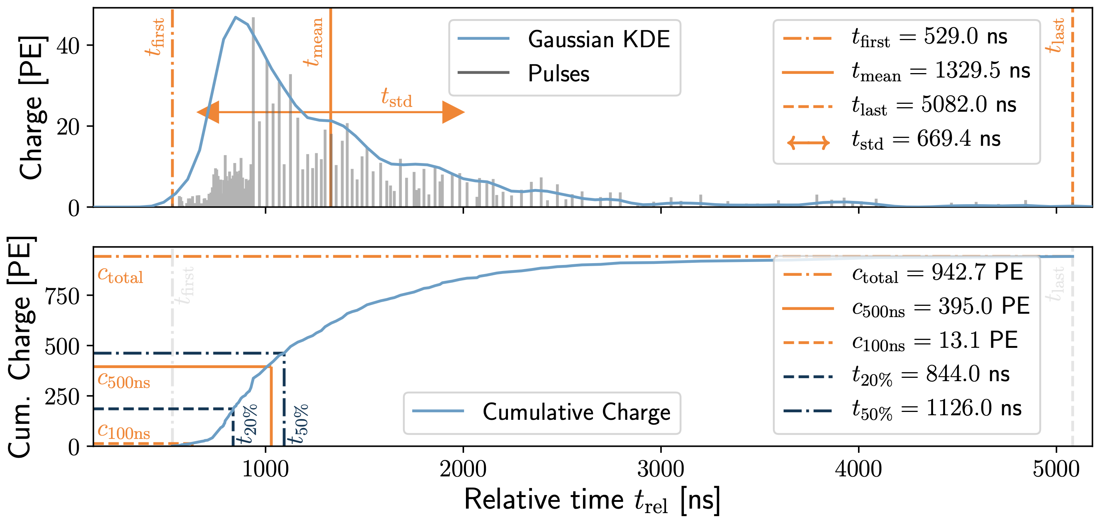
DNN Reconstructions
10.1088/1748-0221/16/07/P07041
Reconstruct
Muon bundle energy
Leading muon energy
Direction (zenith/azimuth)
Physics motivation
Muons lose energy stochastically
High leadingness: energy depositions are dominated by large stochastic losses
Low leadingness: stochastic losses sum up and appear continuously
High energies: forward production
High leadingness: small bundle radius
Low leadingness: larger bundle radius
Input data per DOM
Total charge
Sum of charge
Relative time of first pulse
Relative to total time offset, calculated as the charge weighted mean time of all pulses
Standard deviation of first pulse
Charge weighted standard deviation of pulse times relative to total time offset
SplitInIceDSTPulsesTWCleaning6000ns

Slide 24
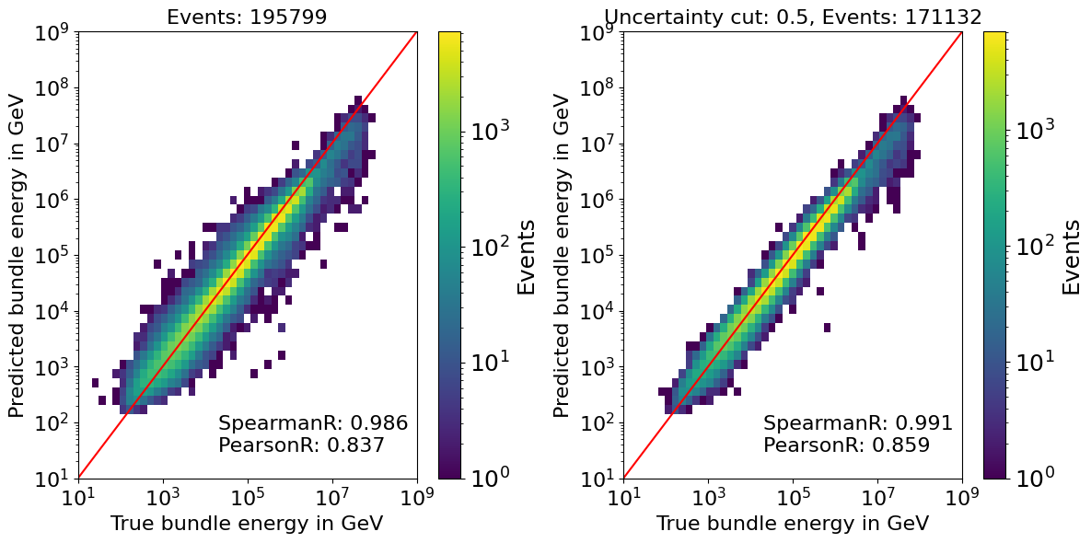
Bundle energy reconstruction

Slide 25
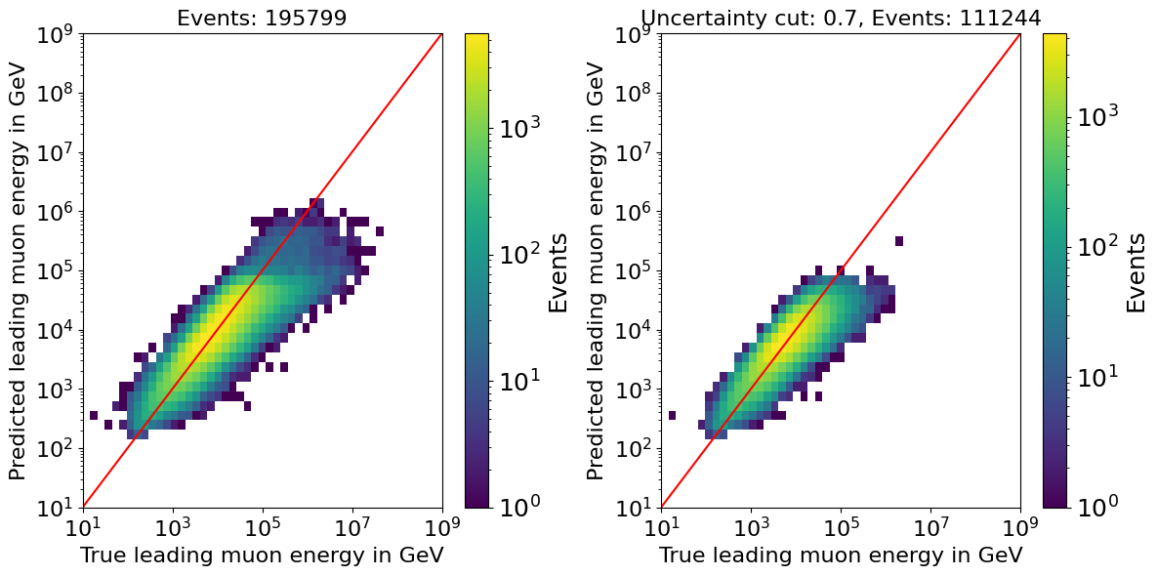
Leading energy reconstruction

Slide 26
Data/MC

Slide 27
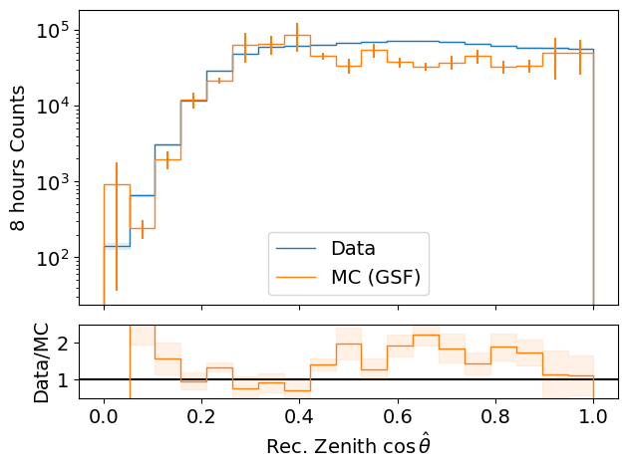
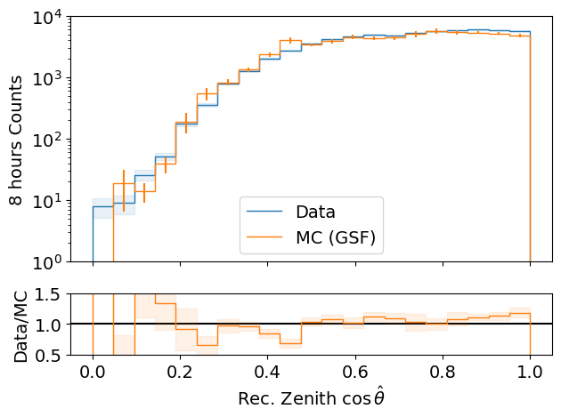
Data-MC: cos(zenith)
processed 8h of experimental data (June 4th, 2020)
L2 MuonFilter
Bundle energy > 100 TeV
L2 MuonFilter
Deviations at low cos(zenith), but very small statistics
More data at cos(zenith) > 0.5
Less data at cos(zenith) ~ 0.3

Slide 28
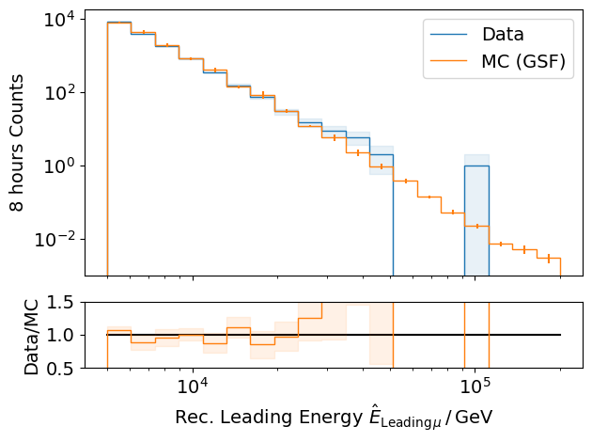
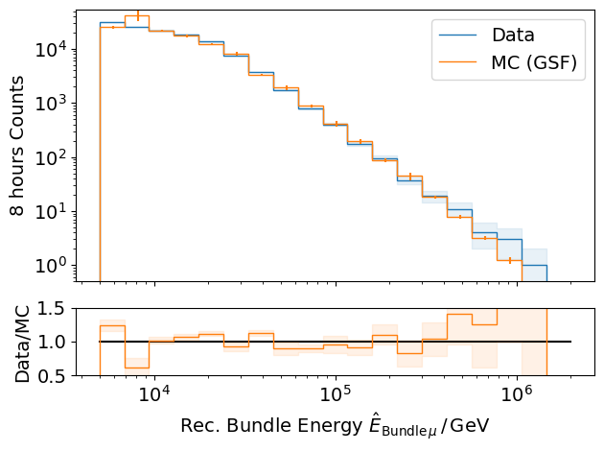
Data-MC: energy spectrum
processed 8h of experimental data (June 4th, 2020)
L2 MuonFilter
L2 MuonFilter
Bundle energy: good agreement with GSF up to 300 TeV
But insufficient statistics

Slide 29
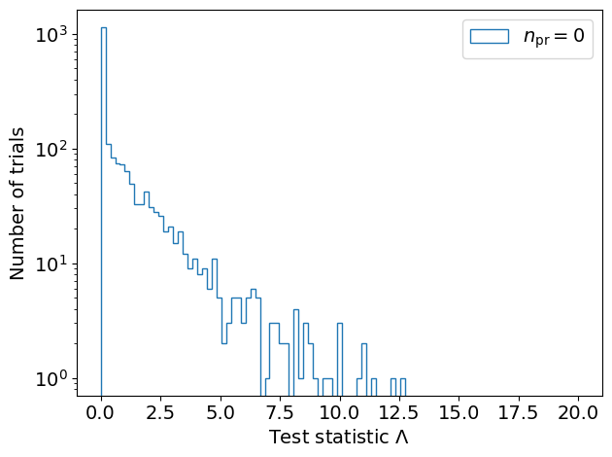
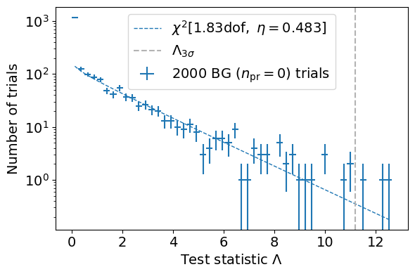
Test background statistics
Cuts:
L2 MuonFilter
Bundle energy > 100 TeV
Background statistic is 𝛘² – distributed
Assume Wilks’ theorem for test statistics

Slide 30
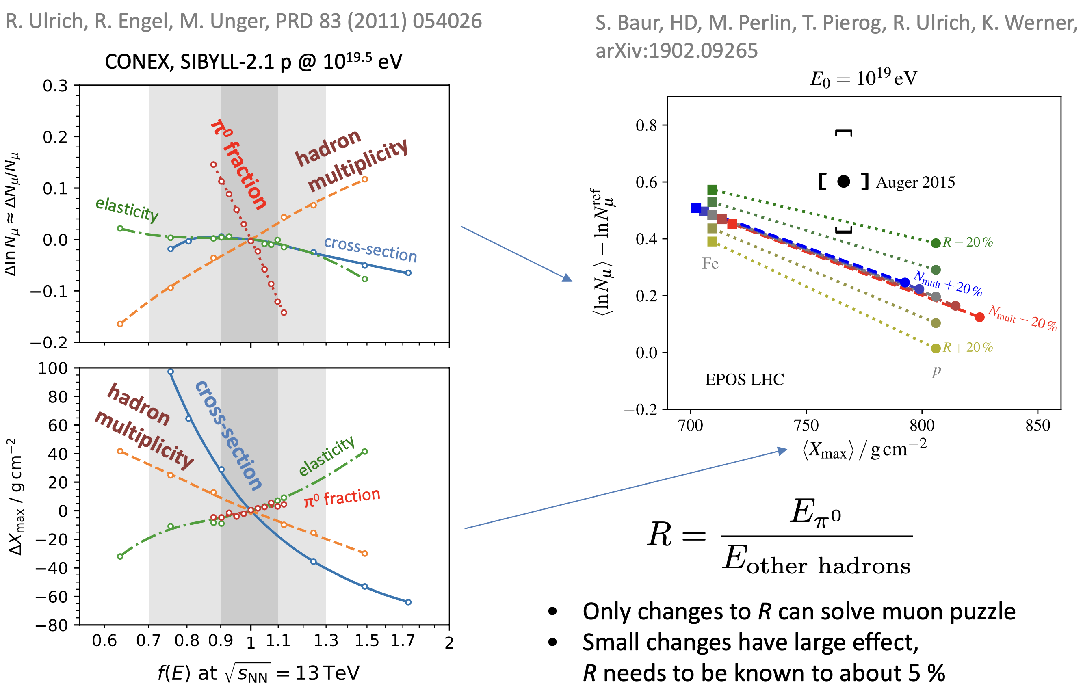
Possible Solutions
Hans Dembinski

Slide 31
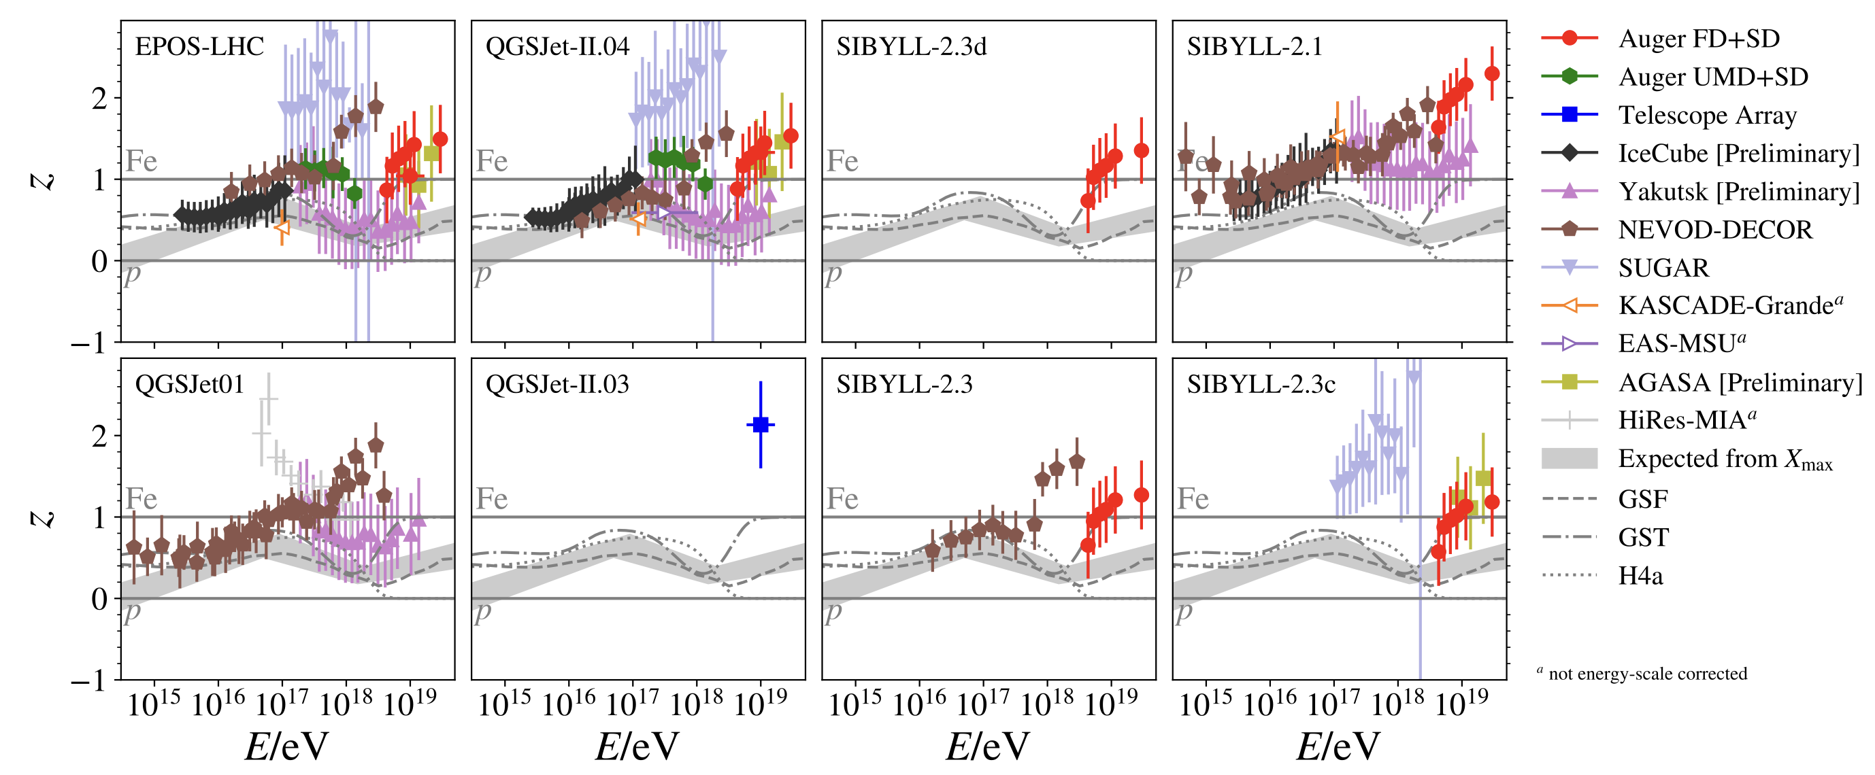
The Muon Puzzle
”muon number”
2108.08341

Slide 32
Some definitions and wording…
Leading muon
The most energetic muon inside a bundle (no minimum fraction required)
Single muon
Except for stopping and very low energetic muons, there are never any single muons (almost every event is muon bundle)
Prompt muon
Muon parent is not pion or kaon
Suggestion:
To avoid confusion regarding different leading muon definitions we can introduce a “leadingness” (For example: Tomasz used a leadingness of 50%, …)
Most energetic muon inside
Muon parent:
pion or kaon
yes
no
conventional
prompt

Slide 33
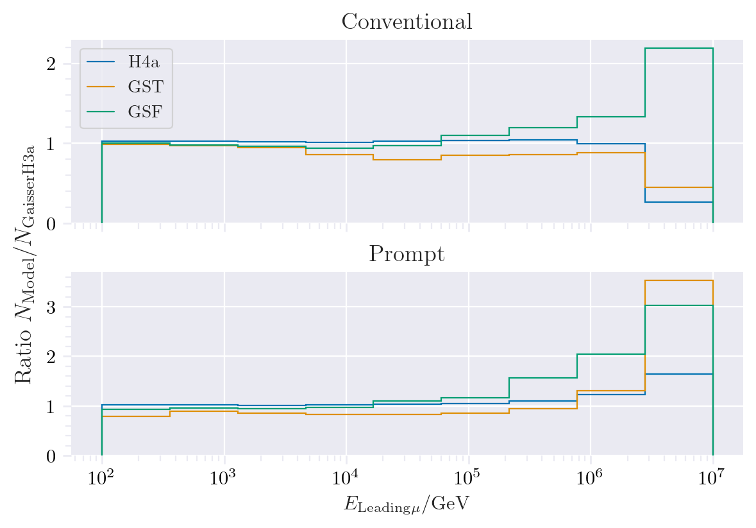
Muon production – different weightings
GST predicts most prompt
MCLabelsLeadingMuons_entry_energy

Slide 34
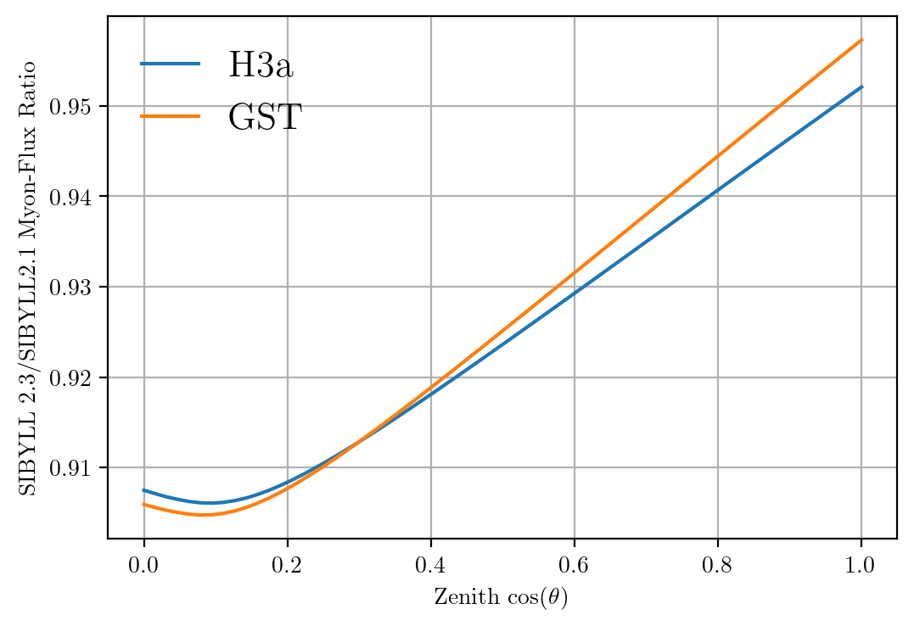
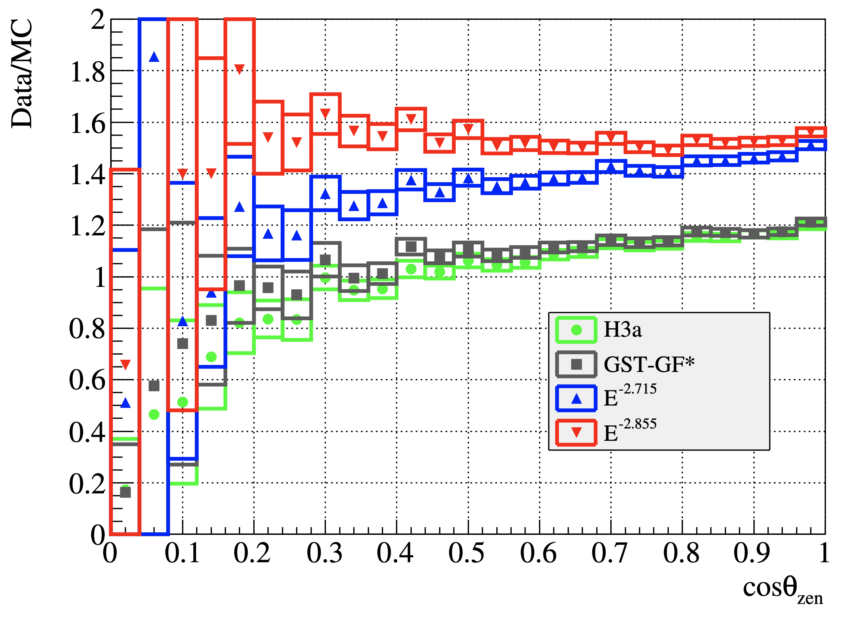
Solution to zenith problem?
No complete solution, but a step in the right direction

Slide 35
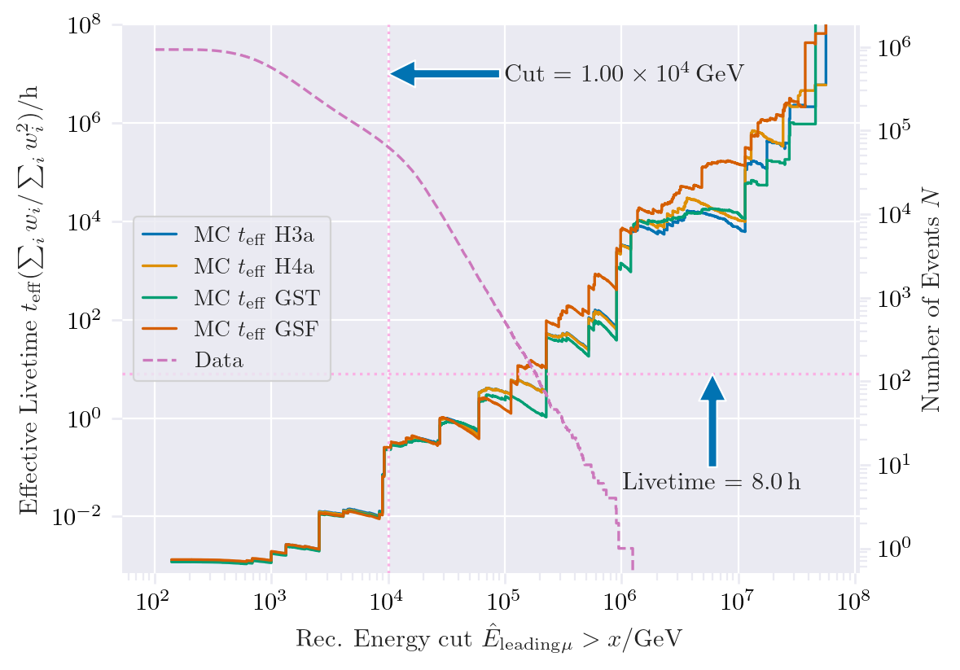
New CORSIKA extended history simulations
CORSIKA 77420
SIBYLL 2.3d
Icetray 1.5.1
5 components (p, He, N, Al, Fe)
Polyplopia: True
Trimshower: True
Ecuts1: 273 GeV (hadron min energy)
Ecuts2: 273 GeV (muon min energy)
Ecuts3: 10²⁰ GeV (electron min energy)
Ecuts4: 10²⁰ GeV (photon min energy)
4 datasets:
30010: 600 GeV – 1 PeV
30011: 1 PeV – 100 PeV
30012: 100 PeV – 1 EeV
30013: 1 EeV – 50 EeV
/data/sim/IceCube/2023/generated/CORSIKA_EHISTORY/
Please go ahead and test the datasets
Sufficient statistics above 1 PeV
Too few statistics at lower energies

Slide 36
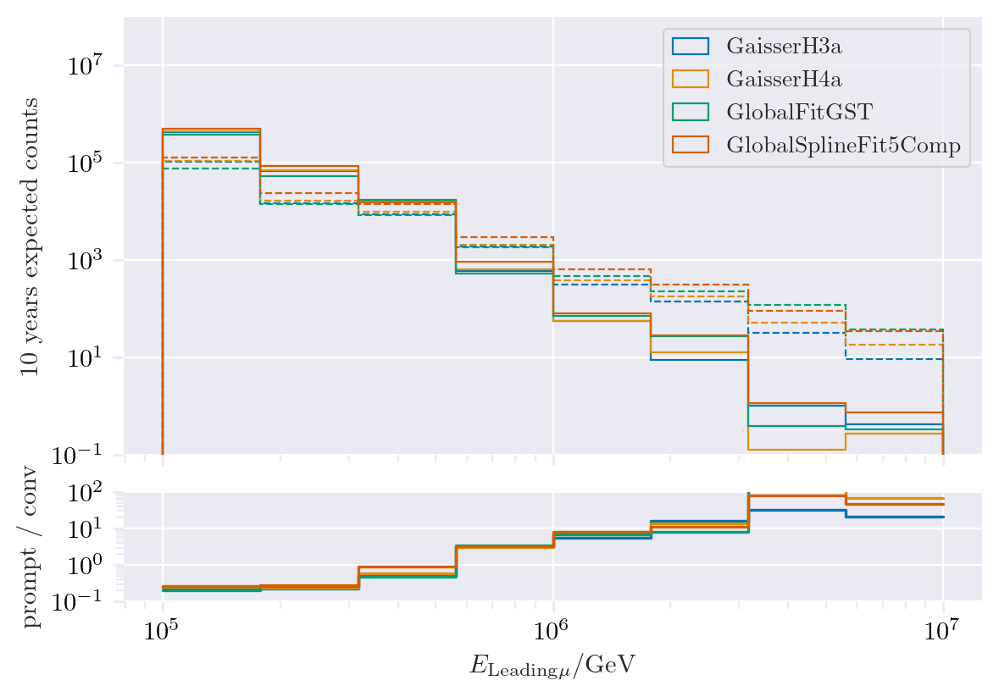
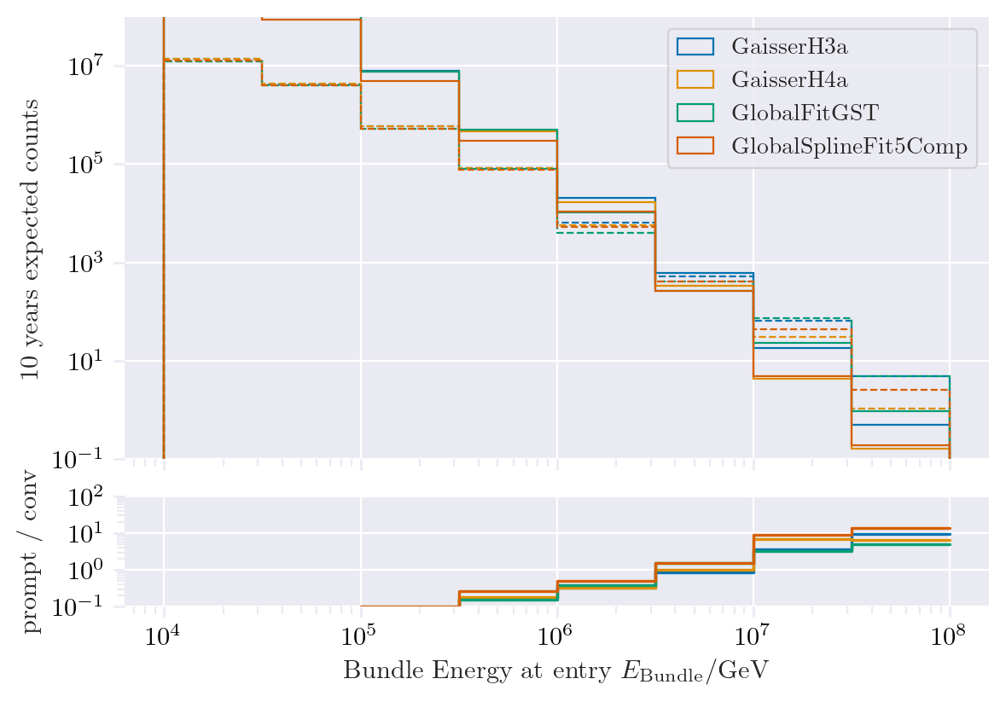
Expected muons for 10 years: leading vs. bundle energy
Solid: conventional
Dashed: prompt
Different primary fluxes lead to different prompt fluxes
Bundle energy extends to higher energies

Slide 37
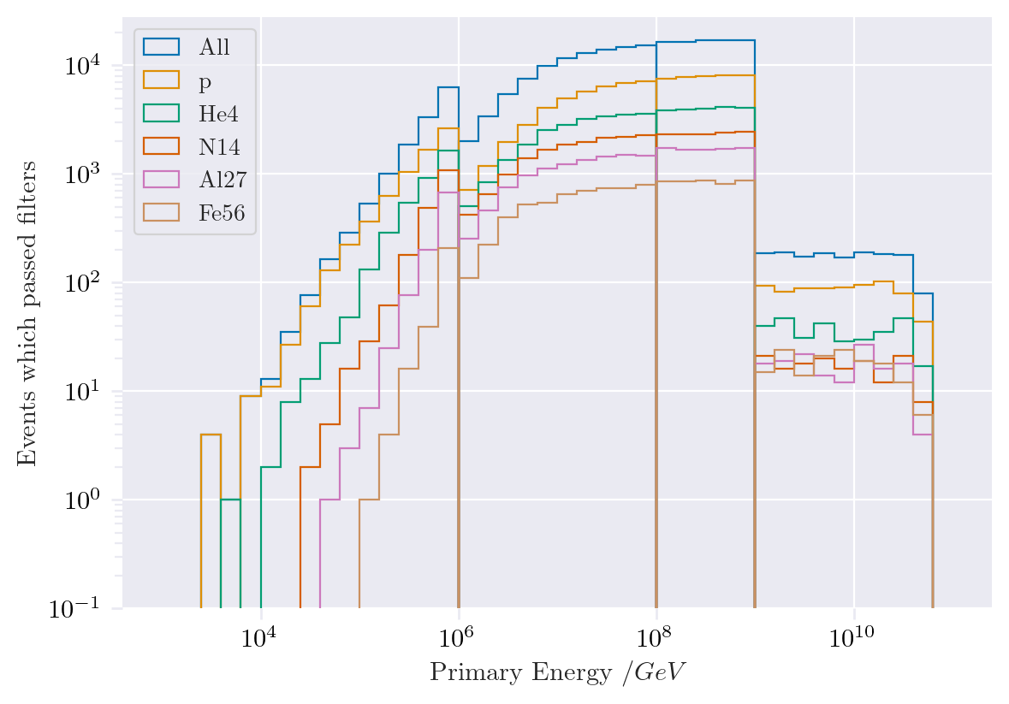
Simulated events
Passed muon filter

Slide 38
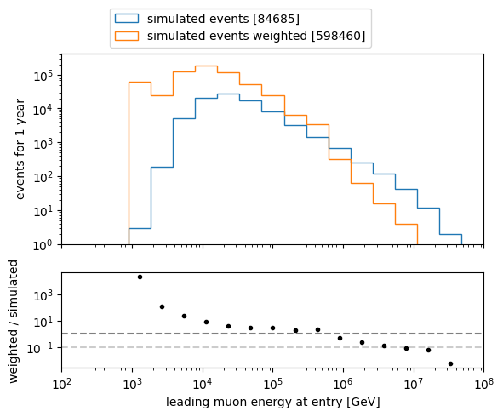
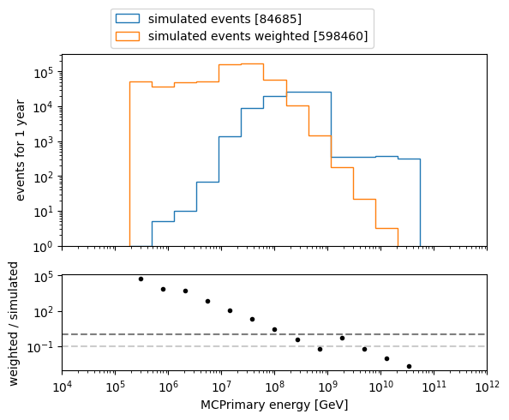
Which energies do we need to simulate?
L2 MuonFilter
Bundle energy > 100 TeV

